Slide 1

Data Wrangling Tool
Poornima N

Slide 2
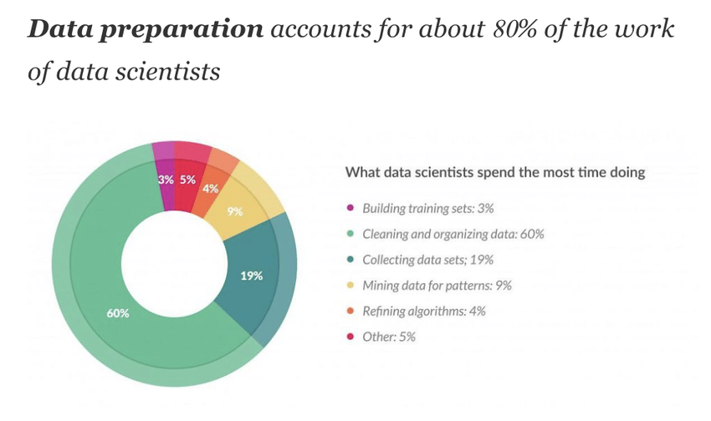
Why ?
Human Errors
Continuous data
Non-standardised data
Multiple sources

Slide 3
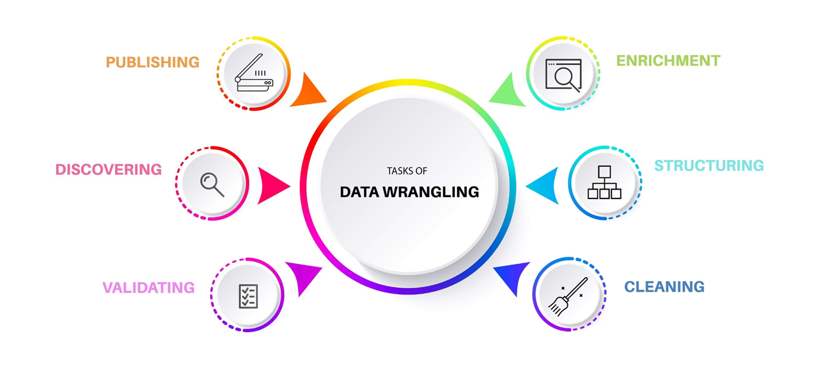
What ?

Slide 4
Proposed Solution
Create Automated tool which accepts multiple formats ( excel, CSV, database, etc..)
Pick only those data that are required for future use
Remove outliers, Null, duplicate, errors, typos and standardize the data
Build library of functions, which can be plugged into the tool to enhance it further

Slide 5
Benefits
Saves Time
Quality and Useable data
Mechanize data flow
Aggregate multiple sources
Handle continuous data
Stops Leakage
Remove Errors

